Slide 1

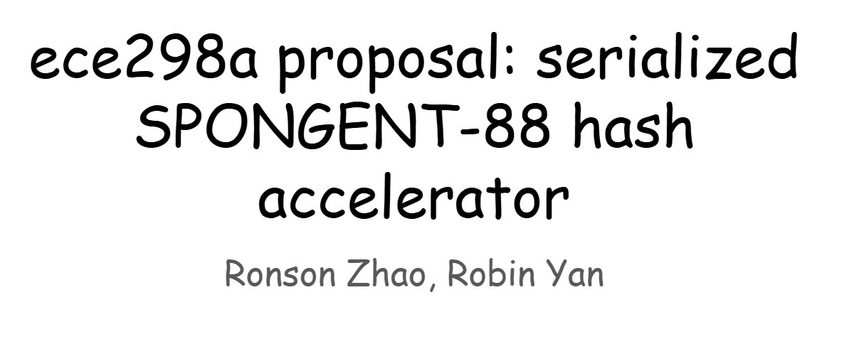


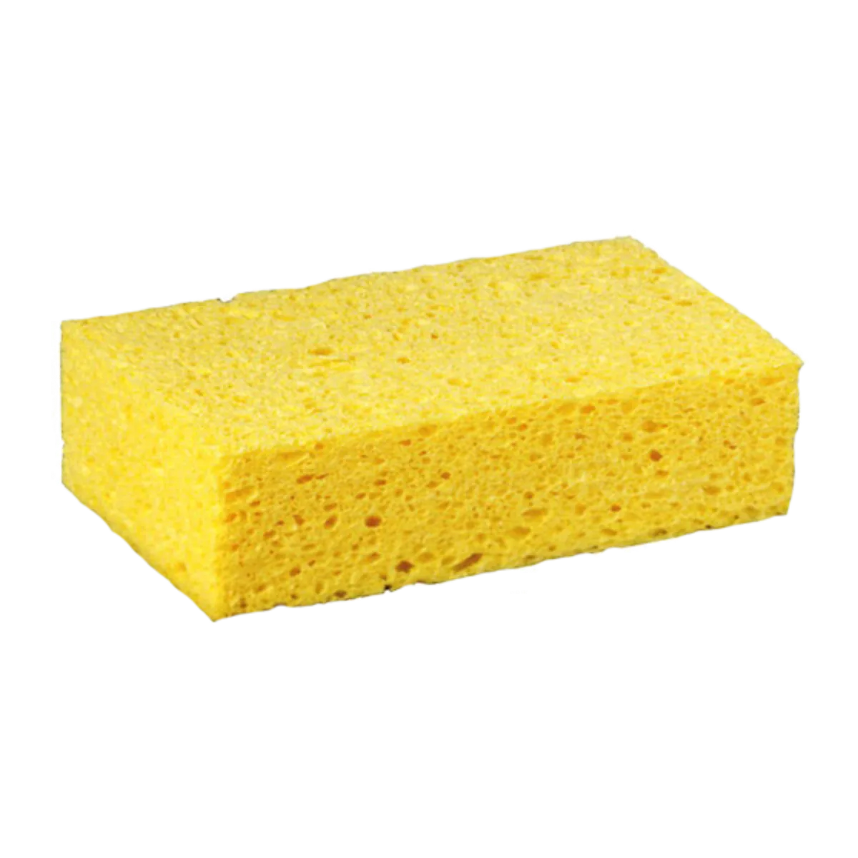

Slide 2
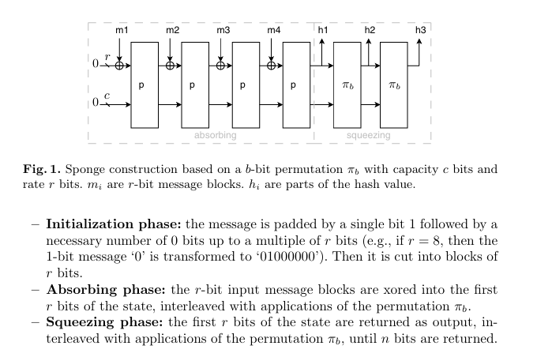
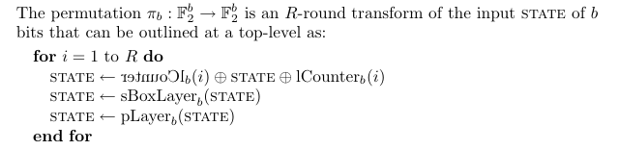

Statement of purpose
We are implementing the SPONGENT-88 hash function [1]. From the original paper: “As crucial applications go pervasive, the need for security in RFID and sensor networks is dramatically increasing, which requires secure yet efficiently implementable cryptographic primitives including secret-key ciphers and hash functions” [1].
According to [1], as of 2011, SPONGENT had the smallest hardware footprint relative to comparably secure hash functions. This is why we chose it.
We will implement this as a SPI peripheral (slave) device. To minimize hardware footprint, we will serialize as much as possible [1].
tl;dr: serialized implementation of SPONGENT-88, a relatively secure hash function

Slide 3
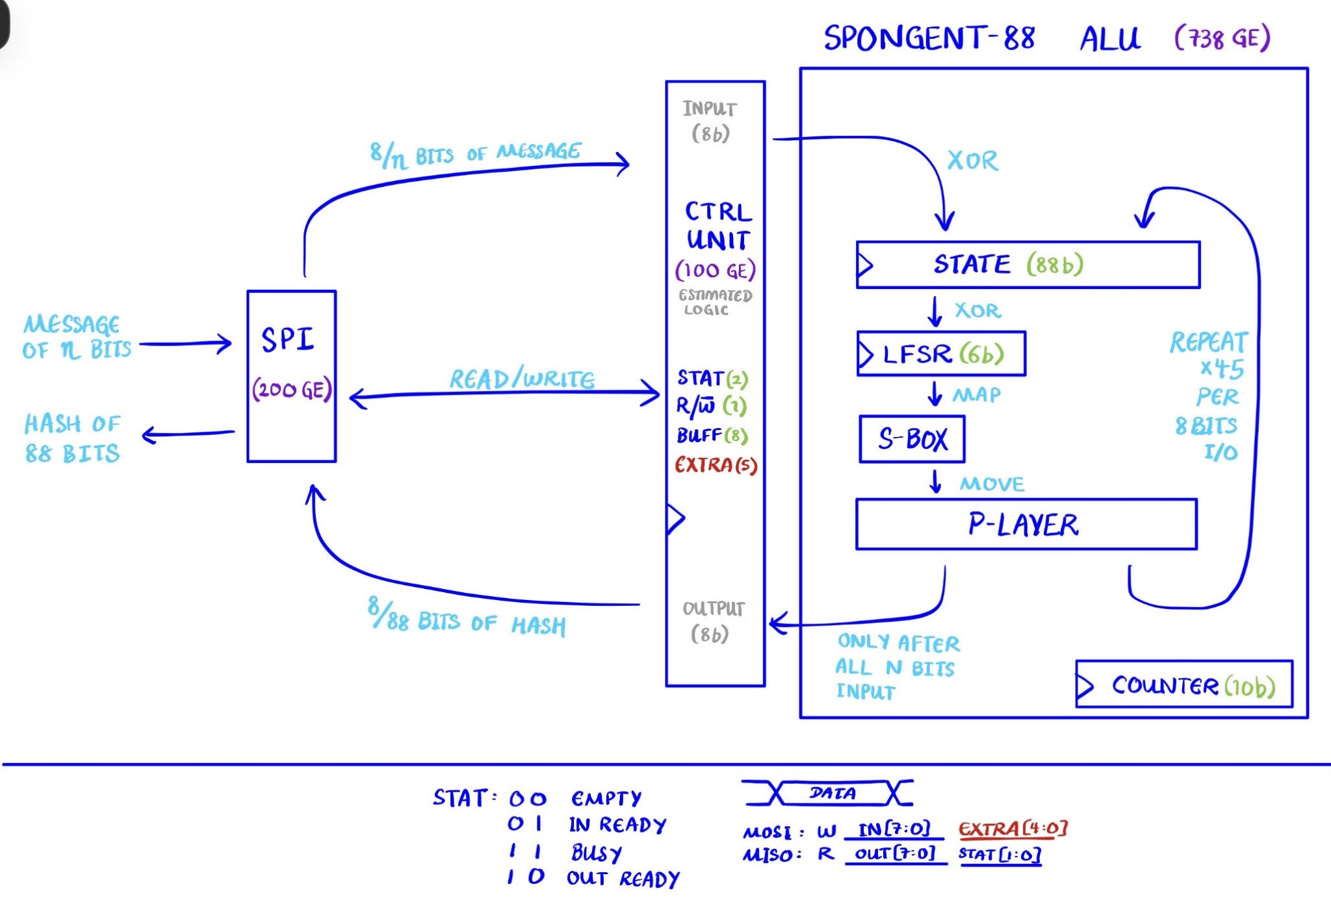

Slide 4
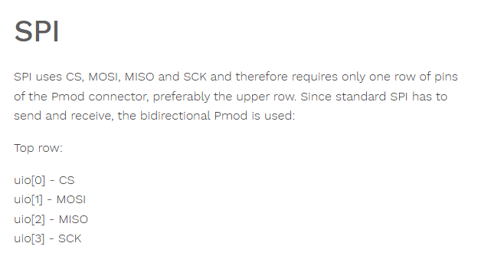



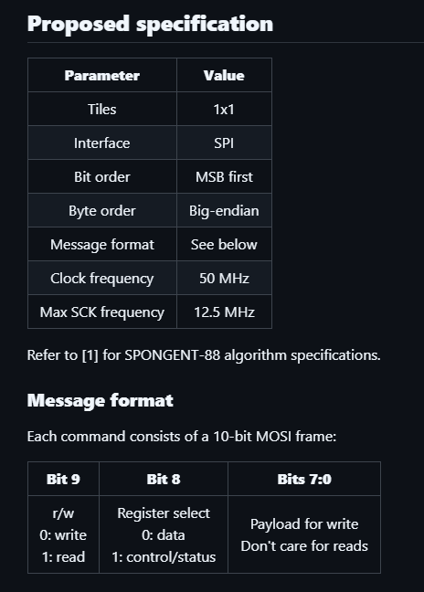





We will use TT’s recommended pinout for SPI
A previous TT implementation of SPONGENT-88 used 4 tiles. We will attempt to only use 1 tile.

Slide 5
References
[1] A. Bogdanov, M. Knezevic, G. Leander, D. Toz, K. Varici, I. Verbauwhede, "SPONGENT: A Lightweight Hash Function," in CHES 2011, 2011, pp. 312-325, doi: https://doi.org/10.1007/978-3-642-23951-9_21.

